Slide 1
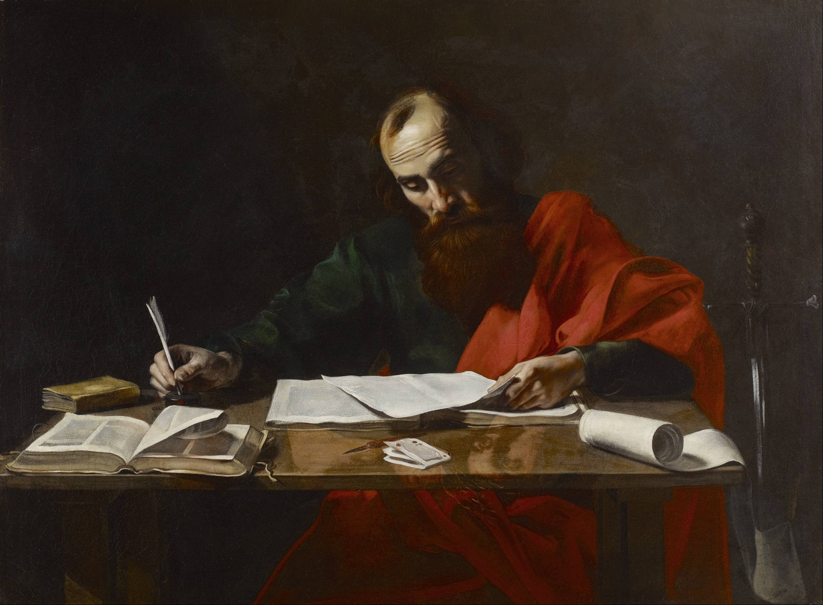
The Trailblazers for God.
Acts 9:20-22
Pastor Rod Lago

Slide 2
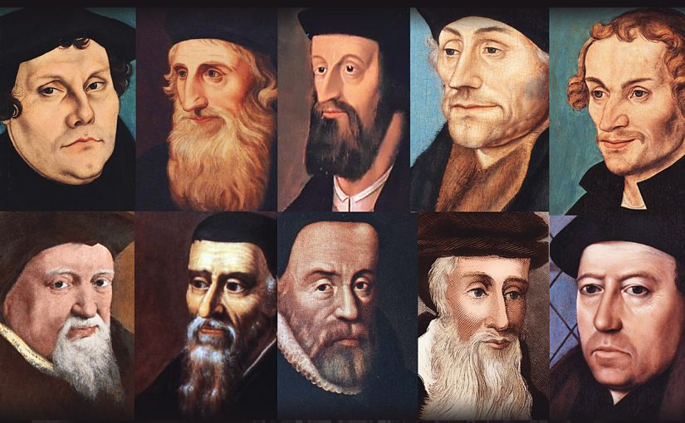

Slide 3
What is TRAILBLAZERS?
A Trailblazers is a person who blazes a trail for others to follow.
A Trailblazers is a Pioneer, an Innovator, a Life long learner, a Mover, a Visionary.
A Trailblazers is a person who builds a better world for others.

Slide 5
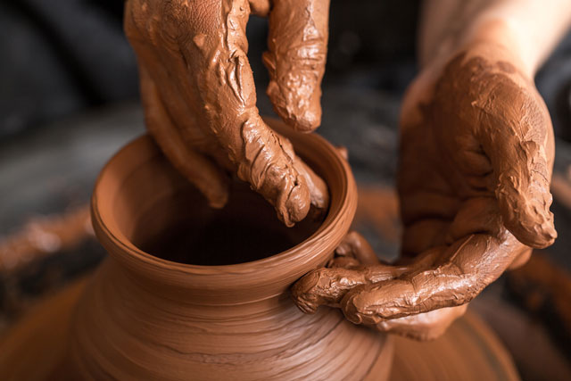

Slide 6
I. The Invisible Hands of the Potter.

Slide 7
“God is Working silently in the background, making you the man and woman He wants you to be.”

Slide 8
“TRAILBLAZERS are men and women who put their Trust and Confidence completely in Christ.”

Slide 9
II. Molding through Negative Experiences.

Slide 10
“TRAILBLAZERS are men and women of FAITH, knowing that Life experiences are God’s preparation for Greater Things.”

Slide 11

III. Conquering the dominating sins.

Slide 12
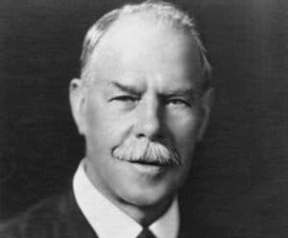


Slide 13

At the same time, you will have to be:
Broken over your sins.
Be willing to take reasonable actions that will help you overcome the sin.
Asking the Power of the Holy Spirit’s help in putting to death the areas of sin.
Spend time Praying and Fasting.

Slide 14
“TRAILBLAZERS are men and women who Conquered dominating sins in their lives because of what Christ had done in the Cross of Calvary.

Slide 15

IV. Learning during the years of Wilderness.

Slide 16
“TRAILBLAZERS are men and women who had build solid foundations for the next generations.”

Slide 17
Conclusions
Don’t be pull down by your background.
Take hardship with a positive mindset knowing God is preparing you.
Overcome the dominating sins in your life, overcome it through discipline and the Power of the Holy Spirit.
Start envisioning your ministry calling and prepare yourself spiritually.

