Slide 1
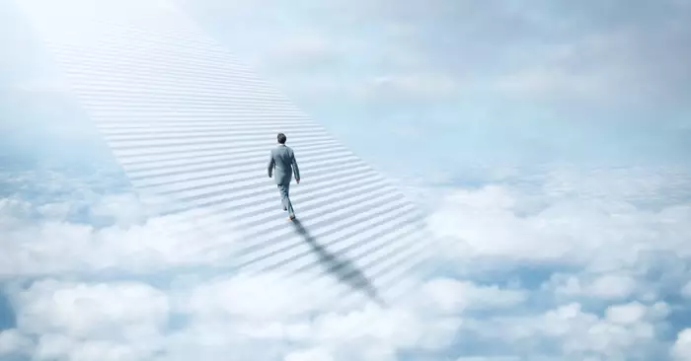
A voice of one calling: 'In the wilderness prepare the way for the LORD; make straight in the desert a highway for our God,'" calling for spiritual readiness for God's arrival, often fulfilled by John the Baptist as the precursor to Jesus, symbolizing repentance and making a path for divine presence.
ISAIAH 40:3

Slide 2
PREPARING
GOD’S WAY
ISAIAH 40:3
SIS. LIEZEL GILVA

Slide 3


PROPHETIC
CALL

Slide 4
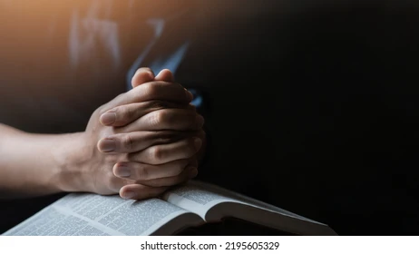
II.
SPIRITUAL
PREPARATION
AND SEPARATION

Slide 5
Be alert and of sober mind. Your enemy the devil prowls around like a roaring lion looking for someone to devour.
I PETER 5:8

Slide 6
the false prophet Zedekiah son of Chenaanah physically strikes the true prophet Micaiah, sarcastically asking how the Spirit of the Lord could leave him (Zedekiah) to speak through Micaiah, after Micaiah revealed God's true, negative message about King Ahab's impending defeat in battle.
I CHRONICLES 18:23

Slide 7
III.
THE PROMISE AND THE FRUIT

