Slide 1
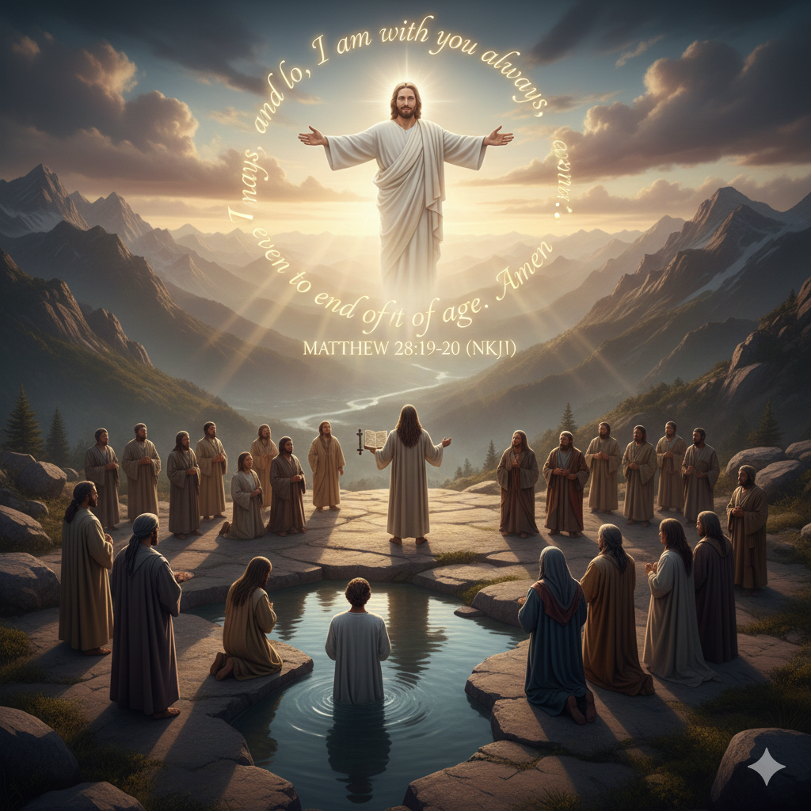
Matthew 28:19-20 (NKJV)
“¹⁹ Go therefore and make disciples of all the nations, baptizing them in the name of the Father and of the Son and of the Holy Spirit, ²⁰ teaching them to observe all things that I have commanded you; and lo, I am with you always, even to the end of the age.” Amen.

Slide 2
Mateo 28:19-20 (MBBTAG)
“¹⁹Kaya't humayo kayo, gawin ninyong alagad ko ang mga tao sa lahat ng mga bansa. Bautismuhan ninyo sila sa pangalan ng Ama, at ng Anak, at ng Espiritu Santo. ²⁰ Turuan ninyo silang sumunod sa lahat ng iniutos ko sa inyo. Tandaan ninyo, ako'y laging kasama ninyo hanggang sa katapusan ng panahon.”

Slide 3
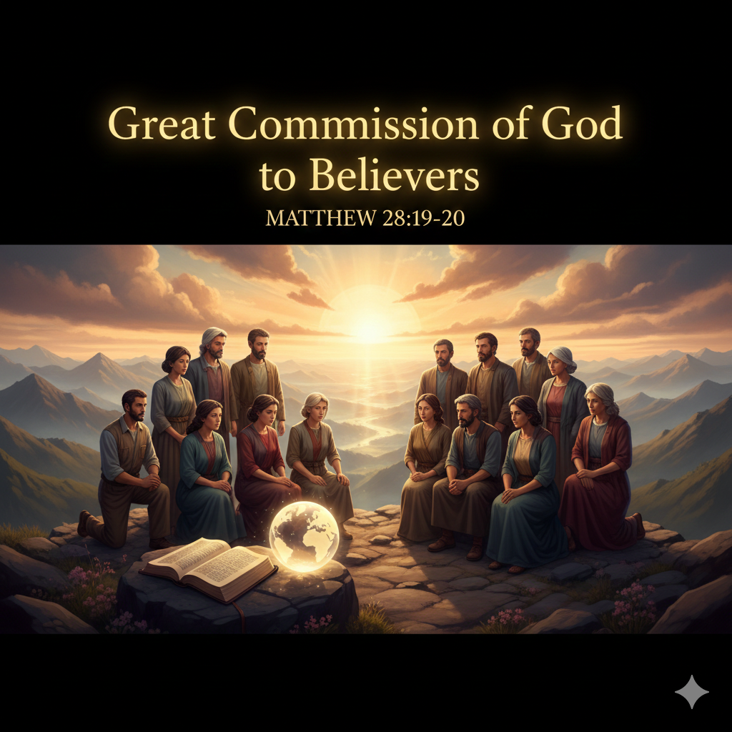

Slide 4
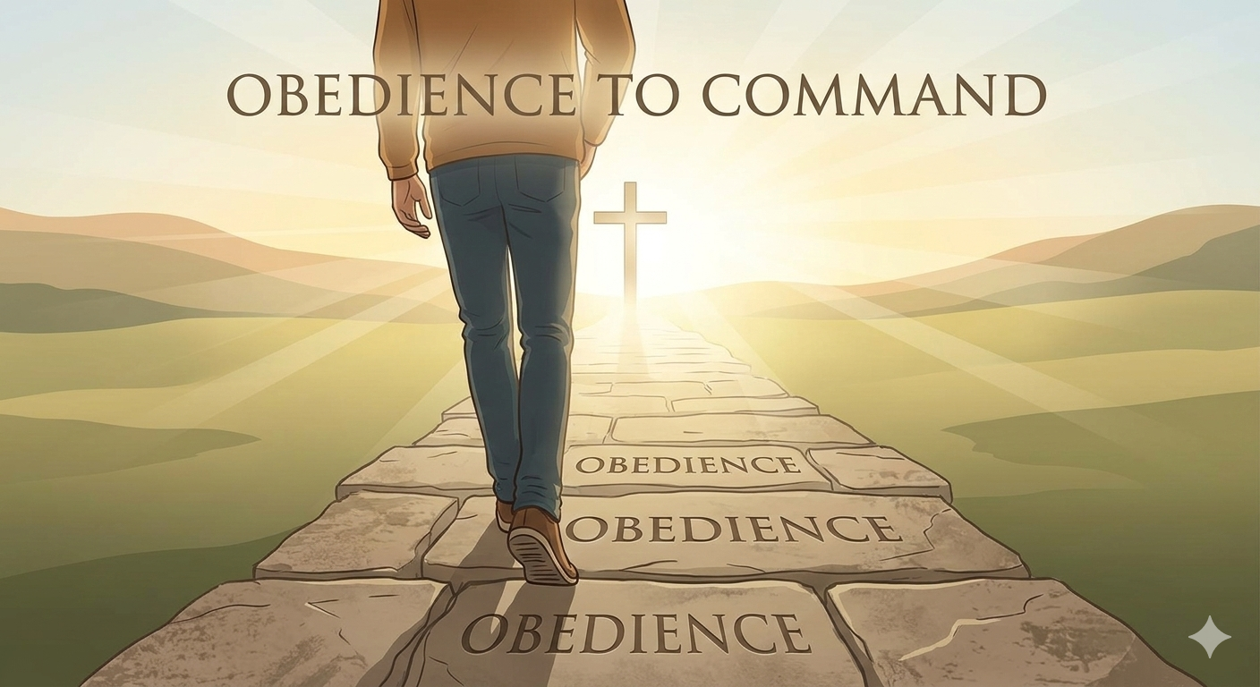
1.
Believers are instructed to spread the Gospel as a mission, to make Jesus known
John 14:15,
1 Samuel 15:22, Luke 11:28

Slide 5
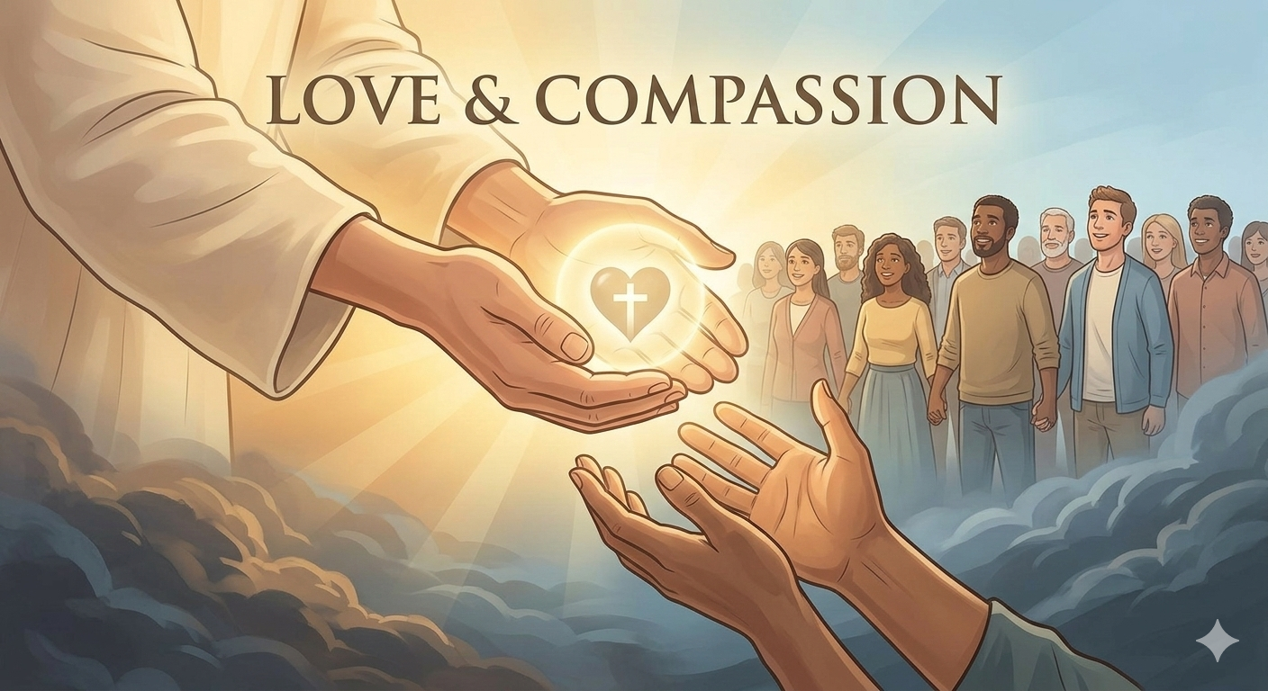
2.
It is an act of love to share the hope of salvation, desiring for everyone to be saved and not lost.
Psalm 103:8, Psalm 145:8, John 13:34, Matthew 22:39

Slide 6
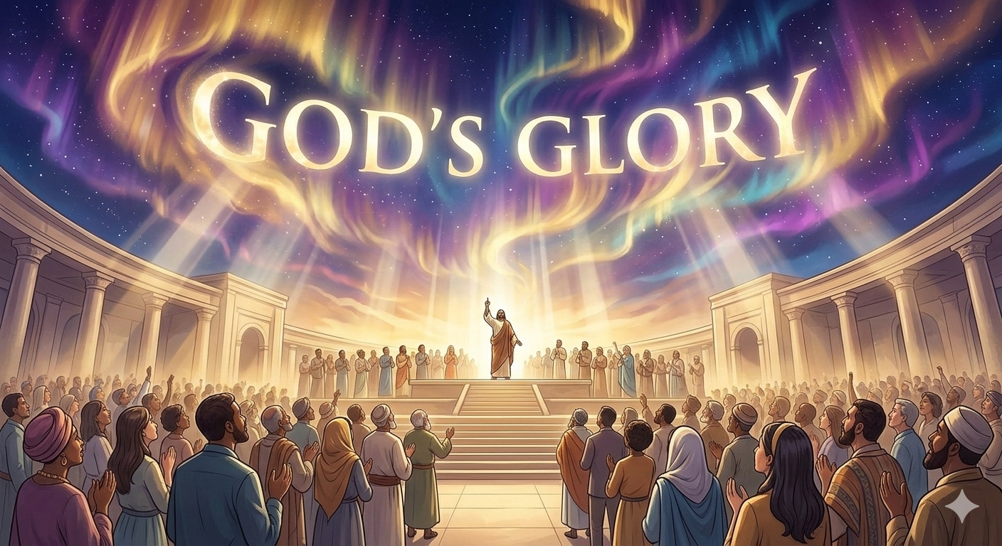
3.
Sharing the message of God exalts God’s name and magnifies Him among the nations.
Psalm19:1 , 1 Cor. 10:31

Slide 7
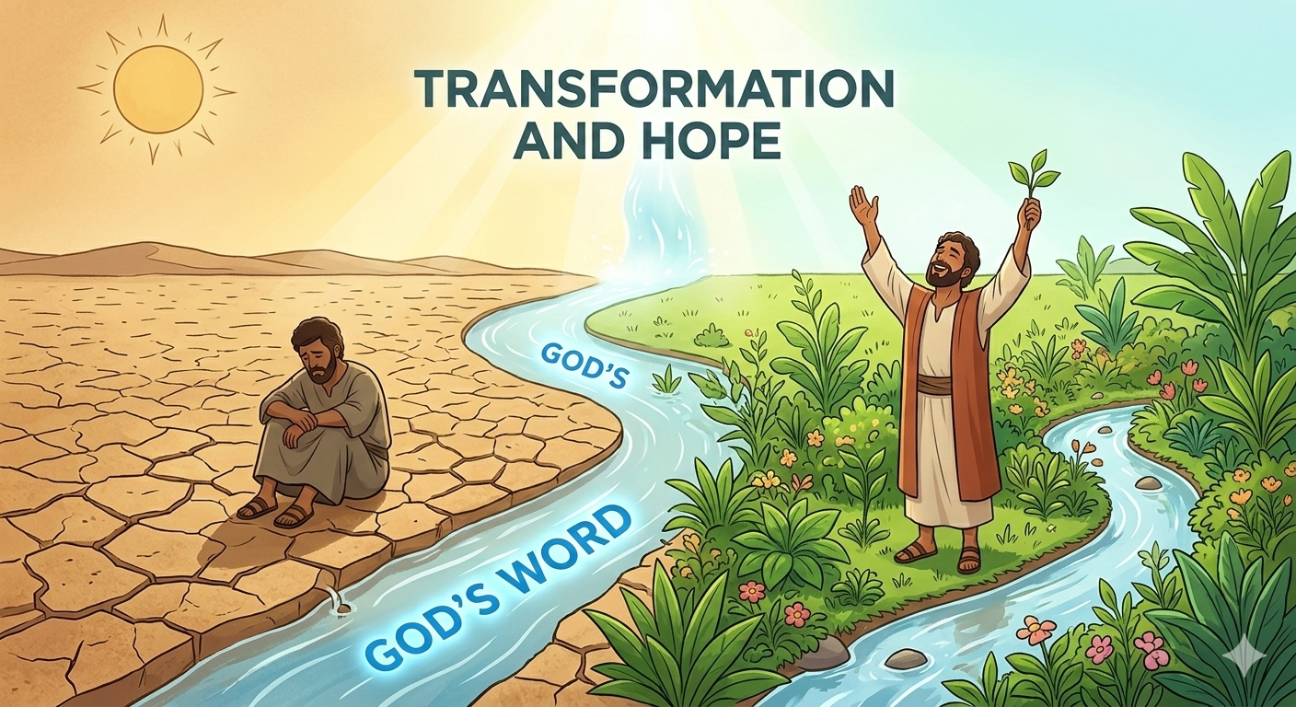
4.
The Word provides, heals and brings hope. Changing lives and strengthens the faith.
Romans 12:29, 2 Cor. 5:17, Jer. 29:11

Slide 8
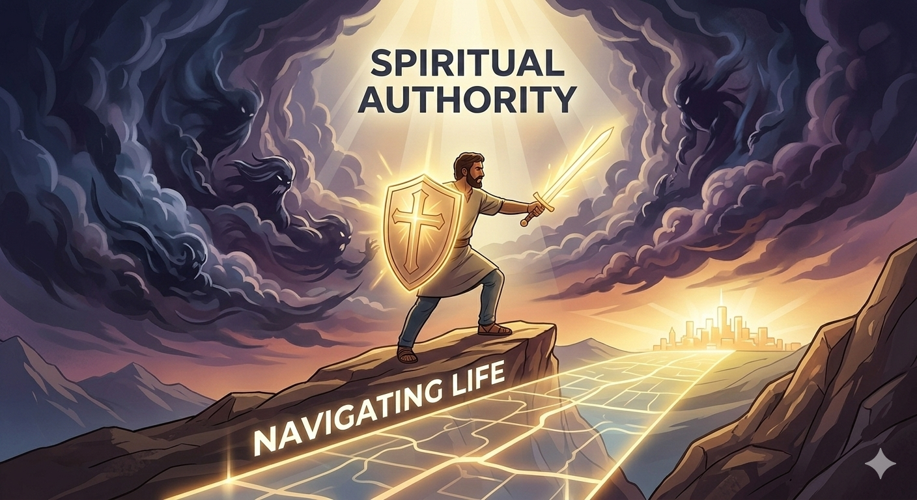
5.
It acts as a tool for spiritual warfare and help navigate life’s challenges through God’s truth.
Luke 10:19, Psalm23:4

Slide 9
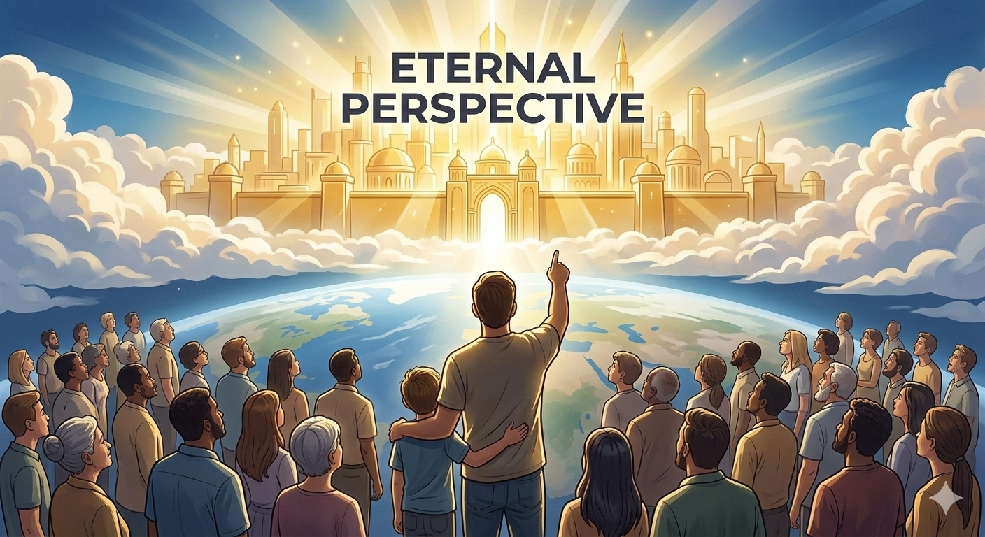
6.
Sharing the Gospel helps build the kingdom and prepares people for eternity.

Slide 10

Colossians 3:1-2
“¹ If then you were raised with Christ, seek those things which are above, where Christ is, sitting at the right hand of God.
² Set your mind on things above, not on things on the earth.”

Slide 11
Sharing the Word of God is a duty for every believer to represent Christ often accomplished through lifestyle, service and testimony.

