Slide 1

Perfect Plan
Jeremiah 29:11

Slide 2
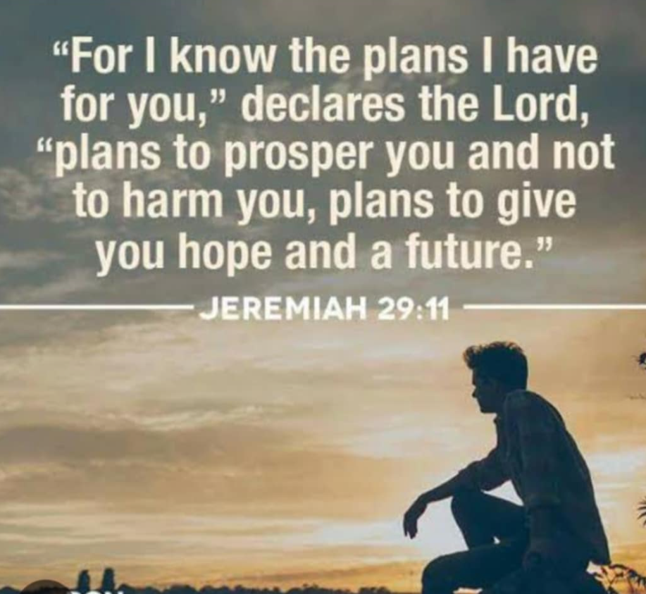

Slide 3
I. Prosperity

Slide 4
Prosperity
1. Invest in our:
  a. Prayer
  b. Devotion
  c. Giving
2. Physical.
  Exercise
  Eating healthy diet
  Avoiding junk food.
3.Financial prosperity

Slide 5
II. Hope

Slide 6
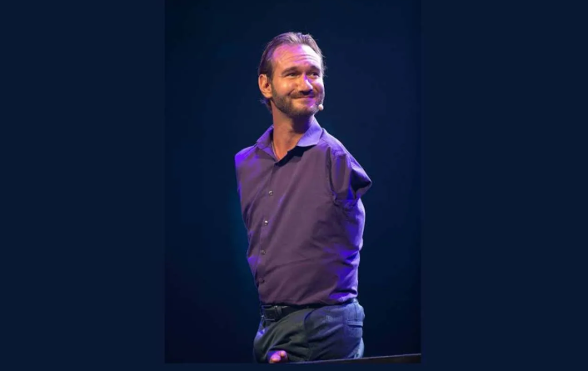

Slide 7
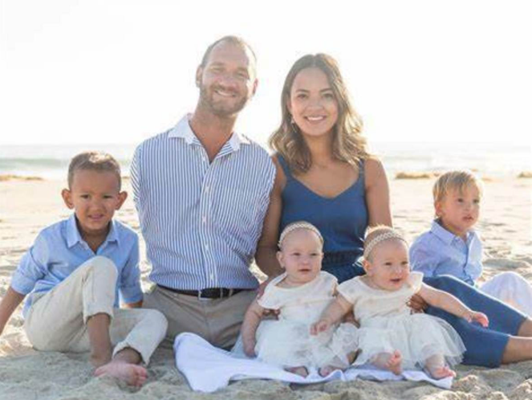

Slide 8
III. Future

Slide 9
Conclusion
What ever your plans commit to the Lord because He promised us to have prosperous life and good future ,No matter what put our trust unto God and sure we will Be victorious and secure in all we do..

Slide 10


Slide 11


